Slide 1
Java Overview

Slide 2
Topics
Overview of order of learning a new language
IntelliJ
Java Overview

Slide 3
First language
Overview of how we will talk about new languages

Slide 4

New languages
Start with required software
Then with a language overview.
Next, in any new language we have a set of near universal structures (10 of them actually), followed by some very common advanced structures.
Lastly, go onto language specialties

Slide 5
The 10 universal structures
Commenting
Output
Input
Selection
Repetition
Assignment
Function
Exception
File I/O
Classes

Slide 6

A few more very common structures
Arrays
Strings and formatting
Enums
Primitives (for that language)

Slide 7

Why?
The goal is to shift from focusing on syntax to logic paradigms. We are going back to thinking in flowcharts and then “translating” to a languages of choice!

Slide 8
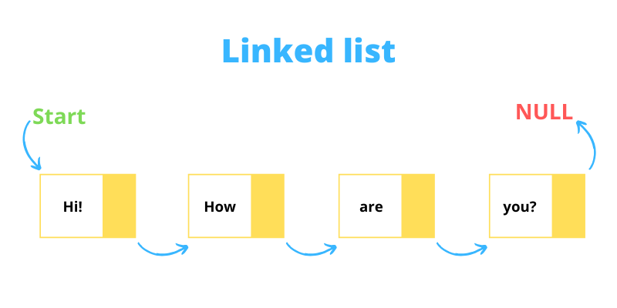
Tip
A good program to write when learning a new language is any basic, linked list collection (linked list, link queue, etc.), using inherited objects (e.g., derive square\circle from shape), with user input and output with error checking, and saving and loading the list state.
This hits all ten, common structures

Slide 9

Intro to Java
Start here

Slide 10

Why Java?
In heavy use
Beats out any one of the C family, individually
But, not the entire C family as a group…
Relatively portable
Good, general-purpose language

Slide 11

Java overview
Generation:
High level
Paradigm:
Imperative/OOP
Location:
Everywhere

Slide 12
Primary Applications
Internet and Web programming
Graphics
GUI programming
Concurrency (threads)
Globalization/
internationalization
Many useful libraries
Embedded systems and mobile devices (Android)
etc. etc. etc.

Slide 13
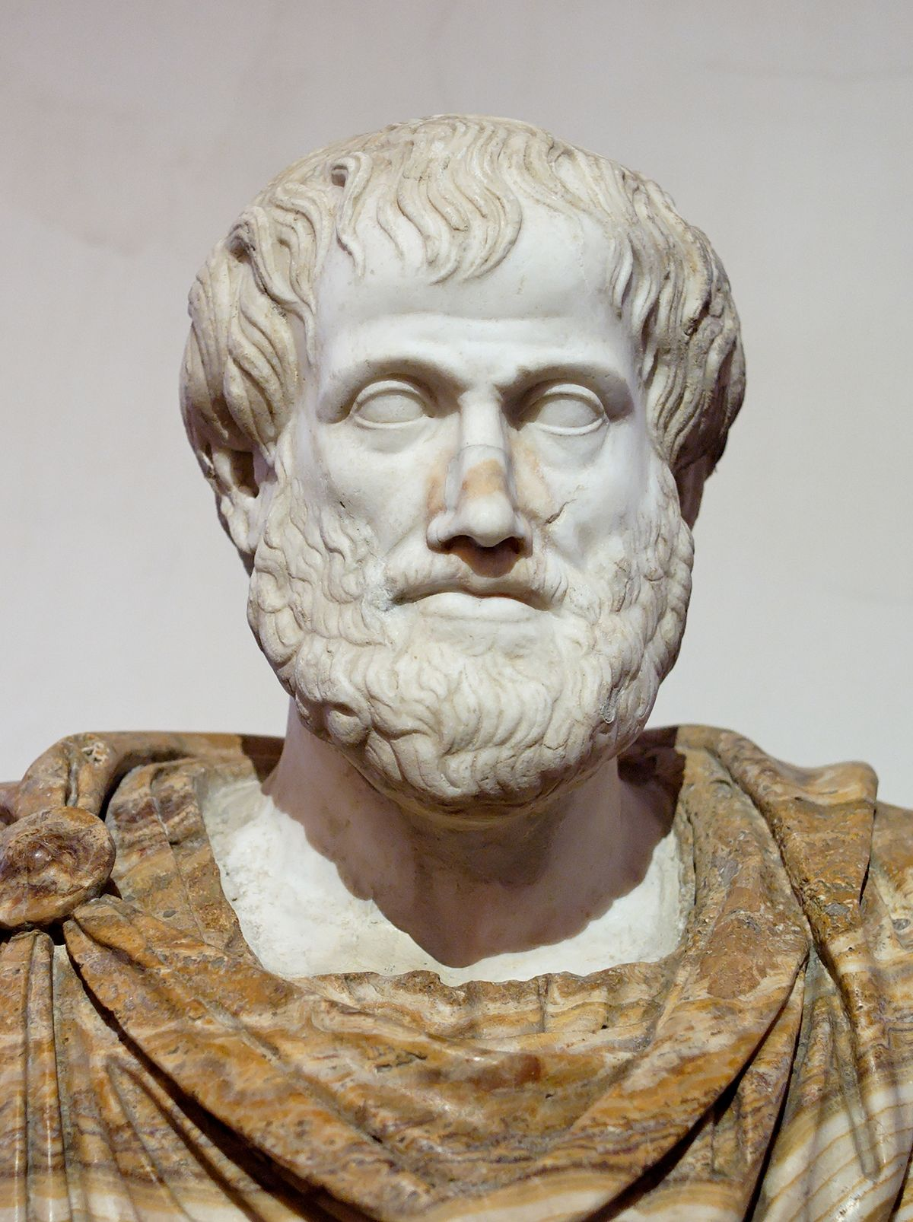

Java Philosophy
Simpler language than C++
(no surprise there)
Portability: Build one, run anywhere
Not true…but better than C++
GUI focused
C-like syntax

Slide 14
Java Philosophy
Modularity
“pure” OOP language
Everything is part of a class
Reliability
Tries to forbid constructs with high rate of misuse

Slide 15
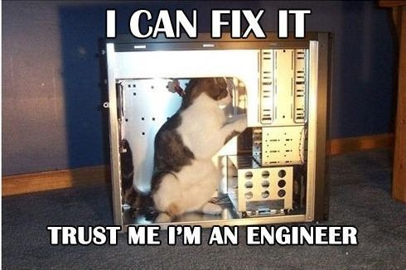
Forbidden constructs
Example of “fixes”
Parameter passing is strictly by value
No default parameter values
No operator overloading
No structs or unions
No typedefs

Slide 16

Forbidden constructs
Example of “fixes”
No explicit deletion of heap-dynamic objects (automatic deallocation via garbage collection)
No multiple inheritance
Much smaller primitive set
Etc.

Slide 17

Java Strengths
Built in GUI support (-ish)
Enforces structures of your files
E.g. cohesive projects
Many built in libraries

Slide 18

Java Weaknesses
Console IO is a pain
Originally meant for a GUI
It got better…
Slower than true compiled languages
Can reverse compilation
Security issue

Slide 19

Java “it depends”
Garbage collection
The language handles clean dynamic memory allocations for you (Yay)
Tends to hit at the worst time (Boo)

Slide 20
QUESTION: Garbage collection
C++ and C, and MANY older language we used new and delete explicitly
Garbage collection finds and deletes unused variables for us
What are the advantages and disadvantages of both?

Slide 21
Answer:
No garbage collection
Garbage collection
Can choose when to run deletion
Faster, since there is not a background process
Memory leaks COMMON
Originally VERY hard to track down memory leaks
Simpler syntax
No memory leaks
Slower
Can be “encouraged in some languages” (set to null encourages it in java, del in python)
Often runs at the worse possible time…
WHY!?

